Slide 1
PUBLISH → FAN-OUT → DELIVER
AWS
Amazon Simple
Notification Service
SNS
A practical seminar on scalable publish/subscribe messaging
Fully managed • Pub/Sub • A2A + A2P
CORE IDEA
One message → many subscribers
Presenter: S.Aswadhama Reddy | Date: 5-10-2026

Slide 2
02
What is Amazon SNS?
Understand the service before looking at the architecture
THE CONCEPT
WHEN SHOULD YOU USE SNS?
Publish / Subscribe
One event must notify multiple systems.
You want loose coupling between services.
You need email, SMS, mobile push, or web endpoints.
You need event fan-out for serverless/microservices.
A fully managed messaging service on AWS.
A publisher sends a message to an SNS topic.
SNS pushes the message to subscribed endpoints.
Supports Application-to-Application (A2A) and Application-to-Person (A2P) notifications.
KEY TERMS
Topic
— Communication channel
Publisher
— Sends message
Subscriber
— Receives message
Fan-out
— One-to-many delivery
Source: AWS Amazon SNS Developer Guide
AMAZON SNS • SEMINAR

Slide 3
03
Architecture: How SNS Works
The topic decouples the publisher from multiple consumers
Amazon SQS
SNS TOPIC
PUBLISHER
OrderEvents
AWS Lambda
HTTP(S)
App / Lambda
Pub/Sub channel
Email / SMS
DELIVERY CONTROLS
Message filtering
→
Retry policies
→
Dead-letter queues
→
Encryption / IAM
→
FIFO ordering
Source: AWS SNS Features & A2A Messaging documentation
AMAZON SNS • SEMINAR

Slide 4
04
Key Features & Benefits
Features that make SNS useful in modern cloud architectures
01
02
03
04
Fan-out
Standard + FIFO
Message filtering
Durability
Publish once and deliver to many subscribers.
Choose broad throughput or ordered, deduplicated messaging.
Subscribers can receive only the messages they need.
Retries and dead-letter queues help handle delivery failures.
05
06
07
Security
A2P notifications
Serverless ready
IAM/resource policies, encryption with KMS, and private connectivity options.
Email, SMS and mobile push support for user-facing alerts.
Integrates with SQS, Lambda, Firehose, HTTP(S) and AWS services.
Result: less custom notification logic + better decoupling
Source: AWS SNS Features & AWS SNS product page
AMAZON SNS • SEMINAR

Slide 5
05
Pricing + Real-World Use Case
Think in terms of messages, deliveries, API activity, and endpoint type
PRICING MODEL
REAL-WORLD USE CASE
No upfront cost
E-commerce Order Event
Typical charges depend on message publishing, notifications delivered, API requests and delivery type. SMS pricing is separate and region/route dependent.
Fulfillment
Checkout
SNS Topic
Customer
COST-CONTROL TIPS
Order service publishes one event.
SNS fans out the event.
SQS/Lambda can process fulfillment while customer notification is handled separately.
Use filtering to avoid unnecessary deliveries.
Monitor usage and delivery metrics.
Check the current regional pricing page before estimating production cost.
Source: AWS SNS pricing guidance and Developer Guide
AMAZON SNS • SEMINAR

Slide 6
06
Practical Demo + Takeaways
A simple console walkthrough you can perform during the seminar
1
Create topic
SNS Console → Topics → Create topic
3 THINGS TO REMEMBER
2
Create subscription
Choose Email / HTTP / SQS / Lambda
01
SNS is Pub/Sub.
3
Confirm endpoint
For email, open the confirmation message and confirm
02
Topics decouple publishers and subscribers.
4
Publish message
Open topic → Publish message → enter subject/body
Fan-out enables scalable event-driven systems.
03
5
Verify delivery
Show the received notification / downstream processing
Demo goal: publish ONE message and visibly show MULTIPLE deliveries.
Thank You
Demo reference: AWS Amazon SNS Getting Started tutorial
AMAZON SNS • SEMINAR

Slide 7
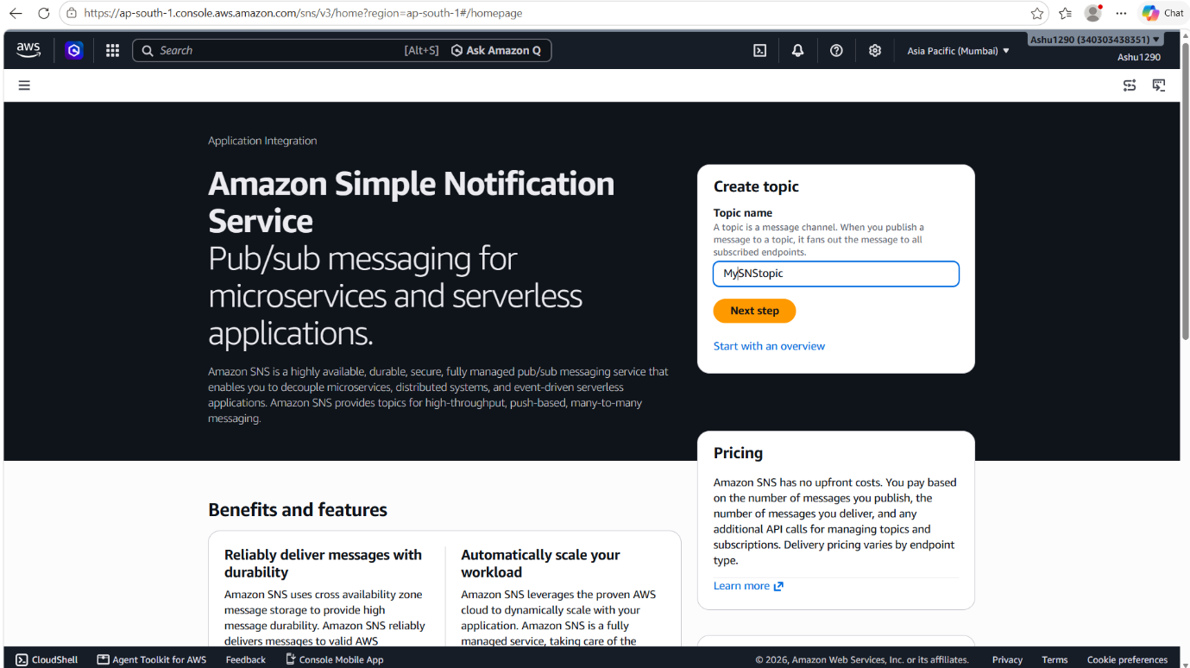
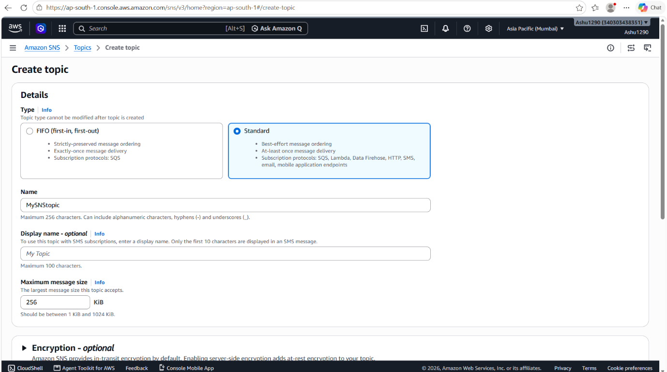
07
Practical Demo — Create the SNS Topic
Evidence from sns2: AWS Console walkthrough, from the SNS landing page to topic creation.
STEP 1 • Open SNS
AWS Console → Amazon SNS → Topics
STEP 2 • Create topic
Choose Standard or FIFO, then enter the topic name.
STEP 3 • Save
Review the configuration and create the topic.
AWS SNS — Create topic entry point
Topic type & configuration
Seminar tip: explain why the topic is the communication channel between a publisher and multiple subscribers.
AMAZON SNS • SEMINAR

Slide 8
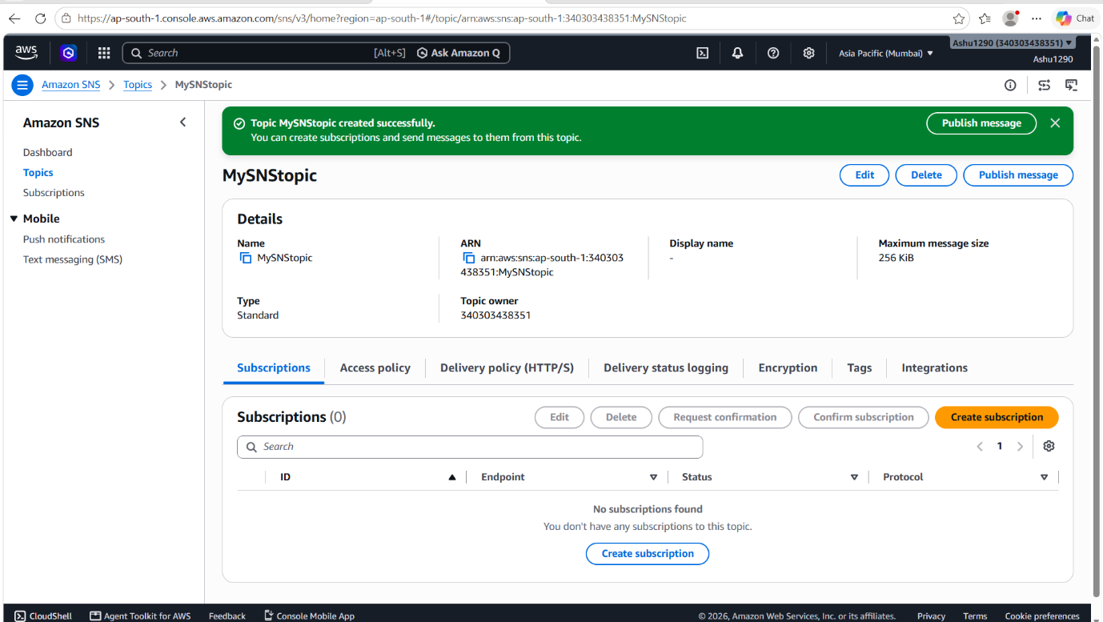
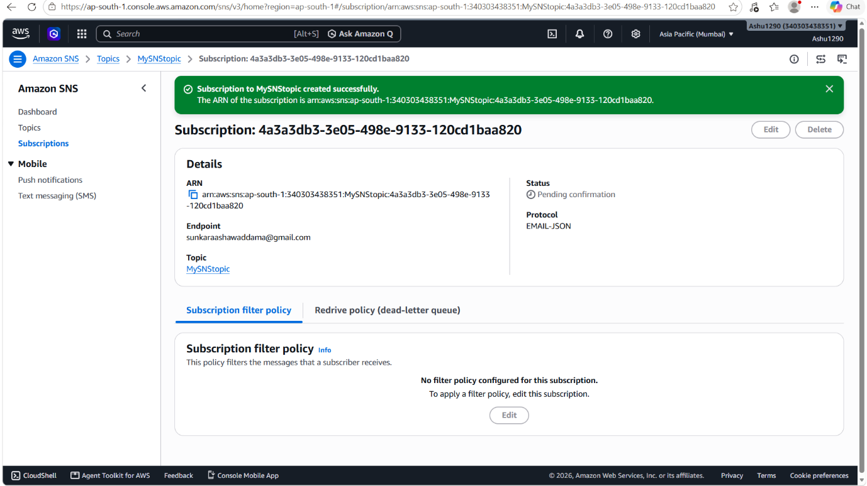
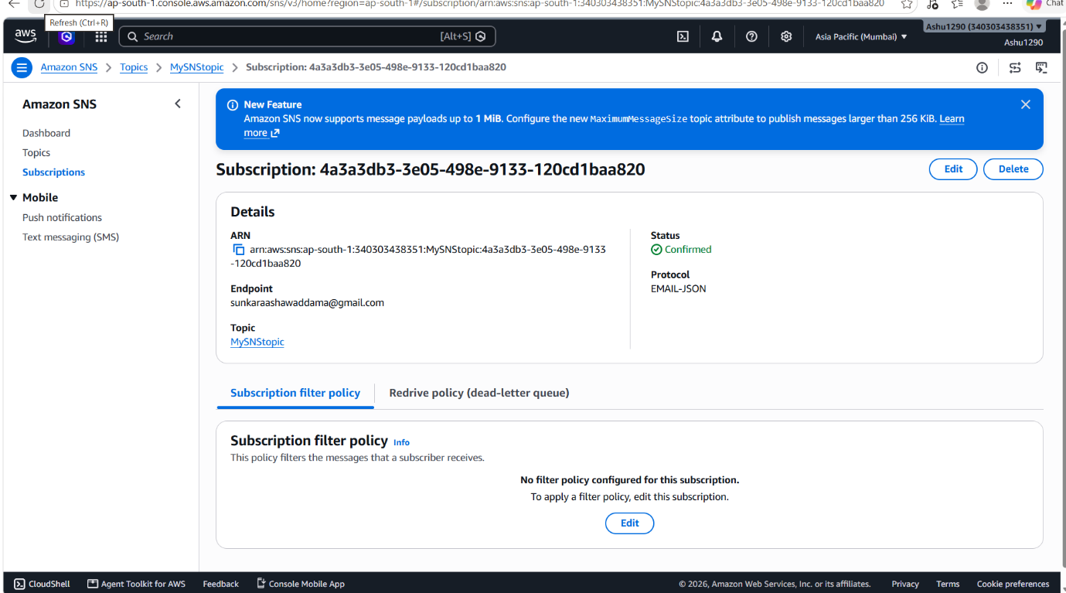
08
Practical Demo — Create & Confirm a Subscription
A subscription connects an endpoint to the SNS topic and defines how messages are delivered.
1 • Create subscription
Select Email, HTTP(S), SQS, Lambda, or another supported endpoint.
2 • Wait for confirmation
Email endpoints require confirmation before delivery begins.
3 • Verify status
Confirmed status means the endpoint can receive notifications.
Topic — Subscriptions
Subscription details
Confirmed subscription
Key concept: SNS separates the publisher from the delivery endpoint, reducing direct coupling.
AMAZON SNS • SEMINAR

Slide 9
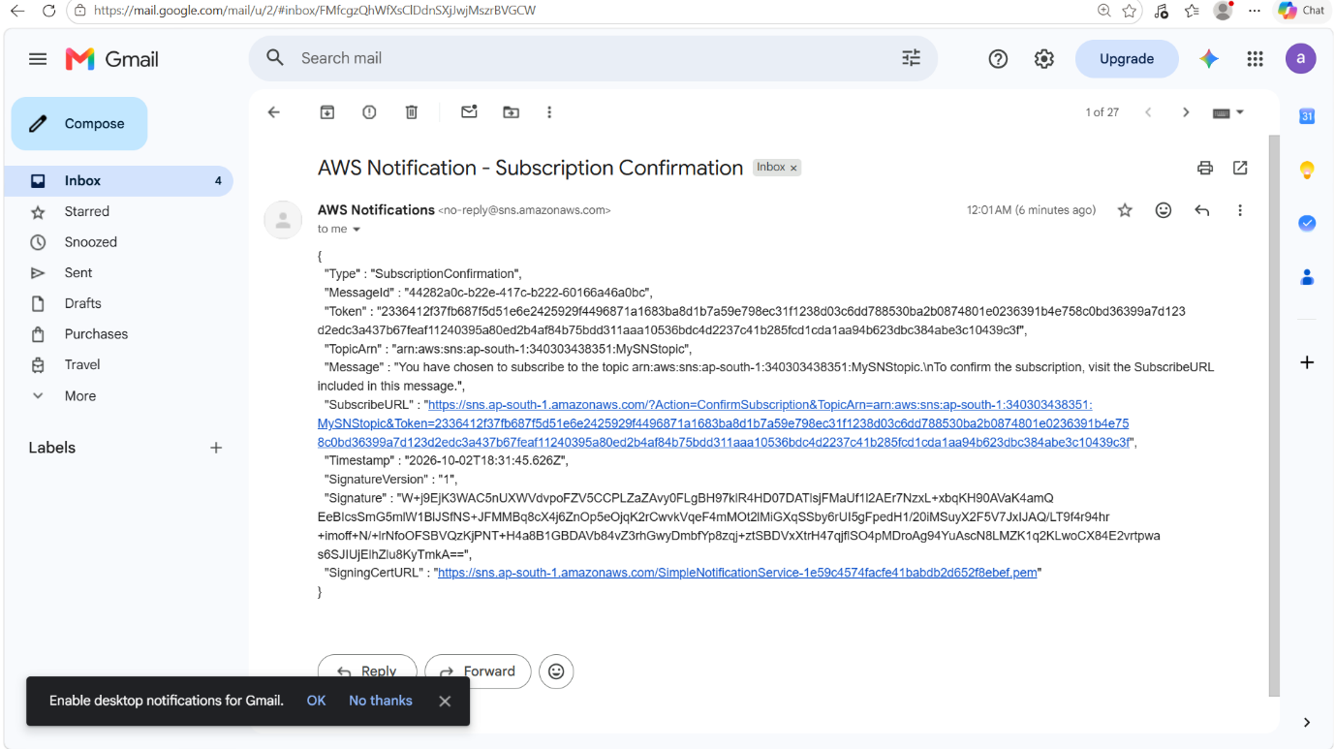
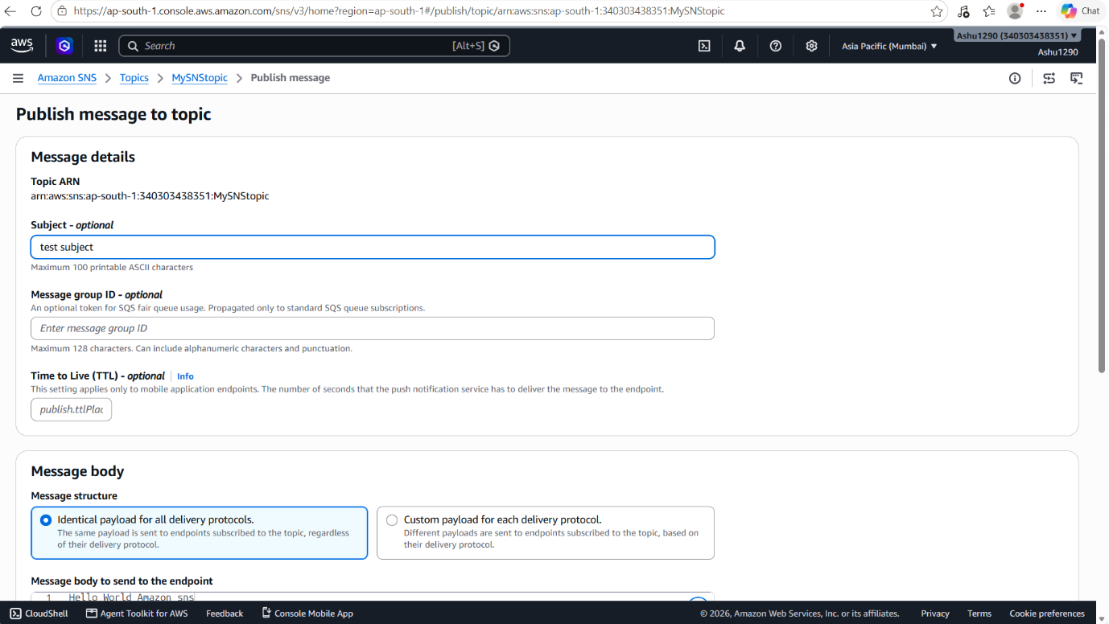
09
Practical Demo — Confirm & Publish
The screenshots show the confirmation email and the SNS console's Publish message workflow.
Email — SNS subscription confirmation
SNS Console — Publish message to topic
LIVE DEMO ACTION
Publish a simple message such as “Order #1234 has been placed” → then show the delivery in the subscriber inbox.
AMAZON SNS • SEMINAR

Slide 10
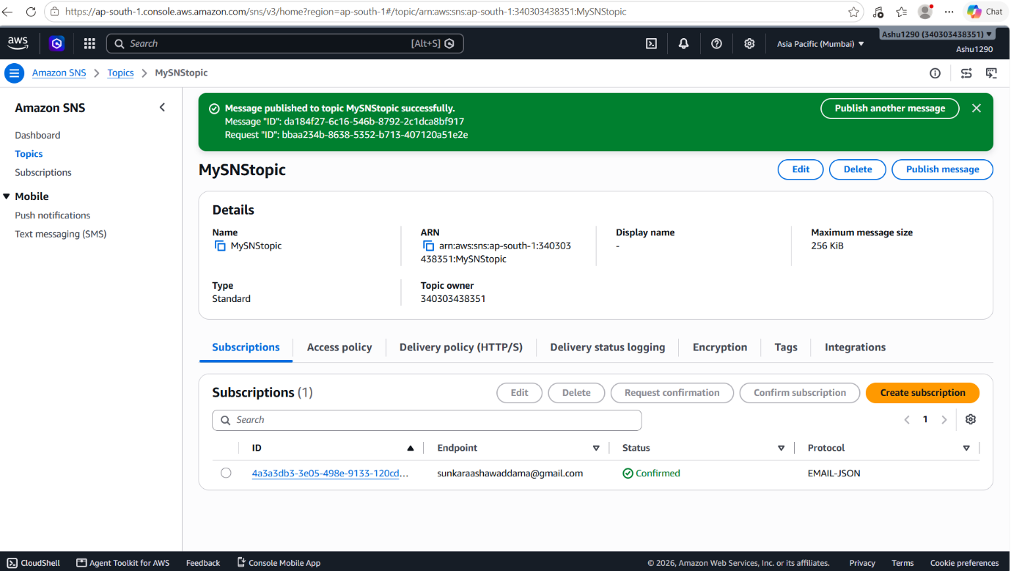
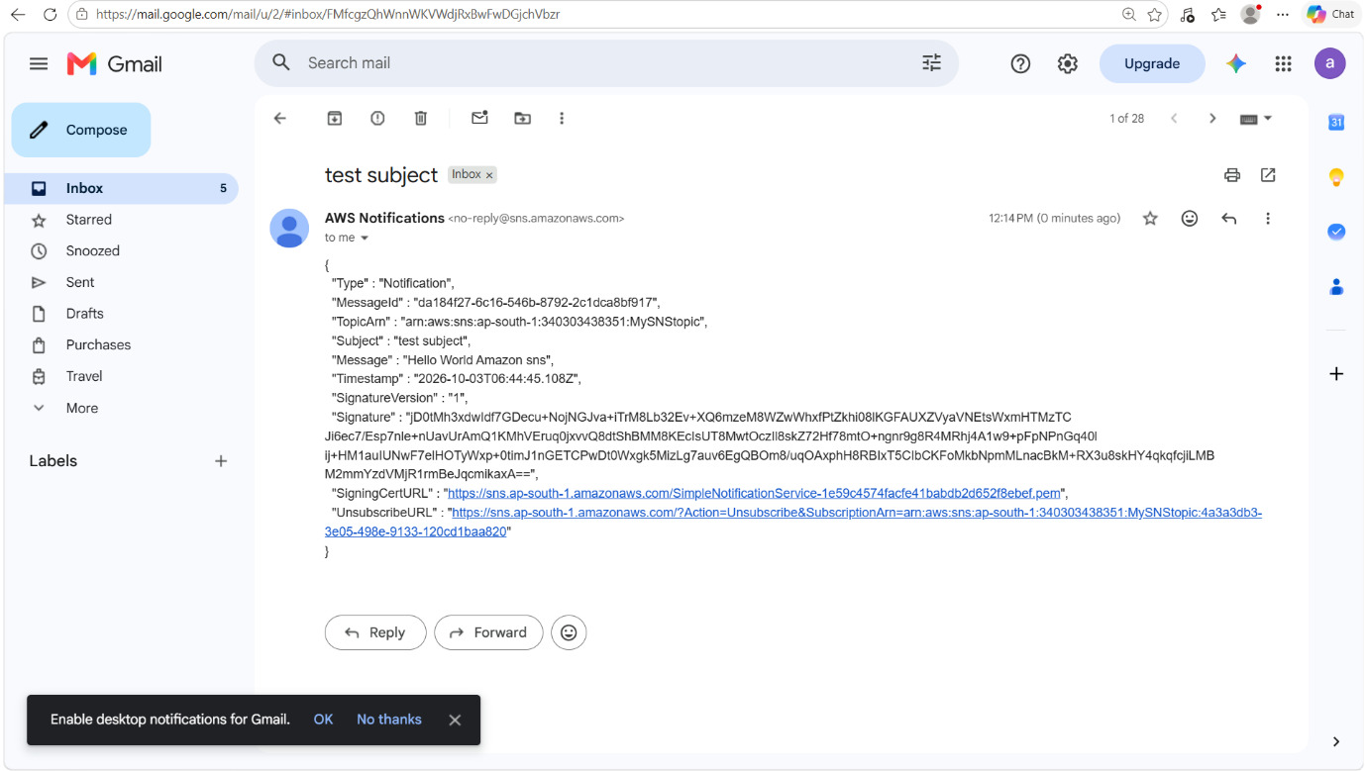
10
Practical Demo — Verify Delivery
Close the loop: show the published message in the topic and the resulting notification in the subscriber inbox.
SNS Topic — message published successfully
Subscriber inbox — received notification
DEMO OUTCOME
ONE PUBLISH → SNS TOPIC → SUBSCRIBER RECEIVES
This visual proof reinforces the seminar's core idea: publish once, then fan out to consumers.
AMAZON SNS • SEMINAR

Slide 11
Conclusion
Amazon SNS enables simple, scalable, and reliable event-driven communication.
01
SNS is a fully managed Publish/Subscribe messaging service.
02
It decouples publishers from subscribers and supports one-to-many fan-out.
03
It integrates with services such as SQS, Lambda, HTTP(S), email, SMS, and mobile push.
04
Message filtering, retries, security, and delivery controls support reliable applications.
05
SNS is especially useful for event-driven, serverless, and microservices architectures.
Key Takeaway: Publish once → SNS fans out → Multiple subscribers receive the event.
AMAZON SNS • SEMINAR

